Slide 1
LLM in Healthcare

Slide 2
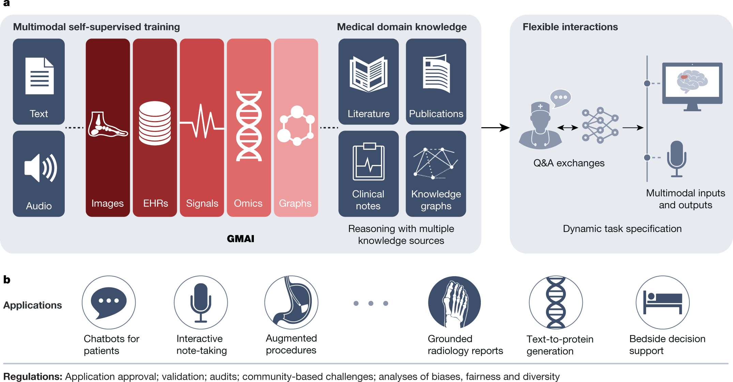
Foundation models
Large and reusable AI model trained on enormous quantities of unlabeled data and generalized to any tasks
https://blogs.nvidia.com/blog/2023/03/13/what-are-foundation-models/
Notes:
Let’s start with foundation models. Concept of foundation model was very recently introduced. It’s one giant model that can be generalized to any tasks. It is large and reusable, and trained on huge quantities of unlabeled data.
One example is here. In this nature paper from Eric Topol and his colleague, they proposed generalist medical AI. Using large biomedical data, either text or omics or knowledgebase, we can train one big giant model in a self-supervised way. Instead of one model for one specific task at a time, this generalist medical AI can do multiple tasks that has never been trained for.

Slide 3
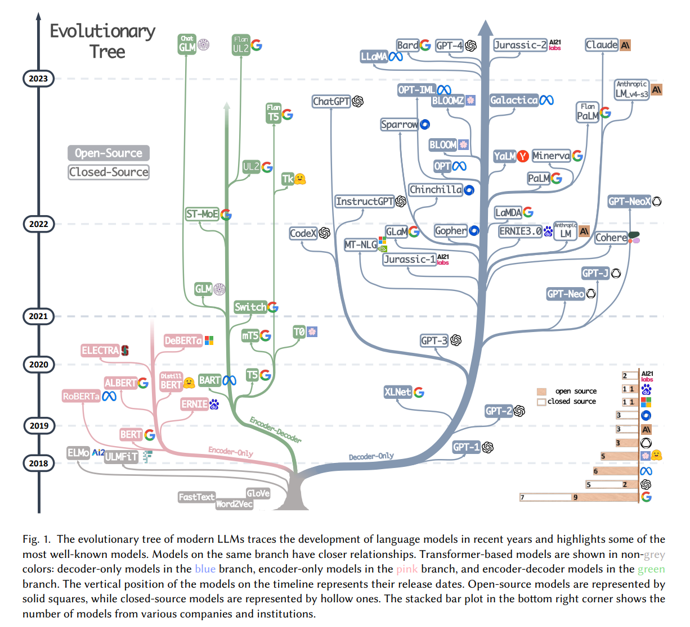
What does Large Language Model (LLM) do?
https://arxiv.org/abs/2304.13712
Notes:
From this example, we can see LLM can do many things.
From language perspective, it understands and generates language. The language is not limited to human language. Computer language, codes..
From knowledge perspective, it memorizes knowledge. And it can do some reasoning based on its knowledge. From this combination, GPT can talk like knowledgeable human.

Slide 4
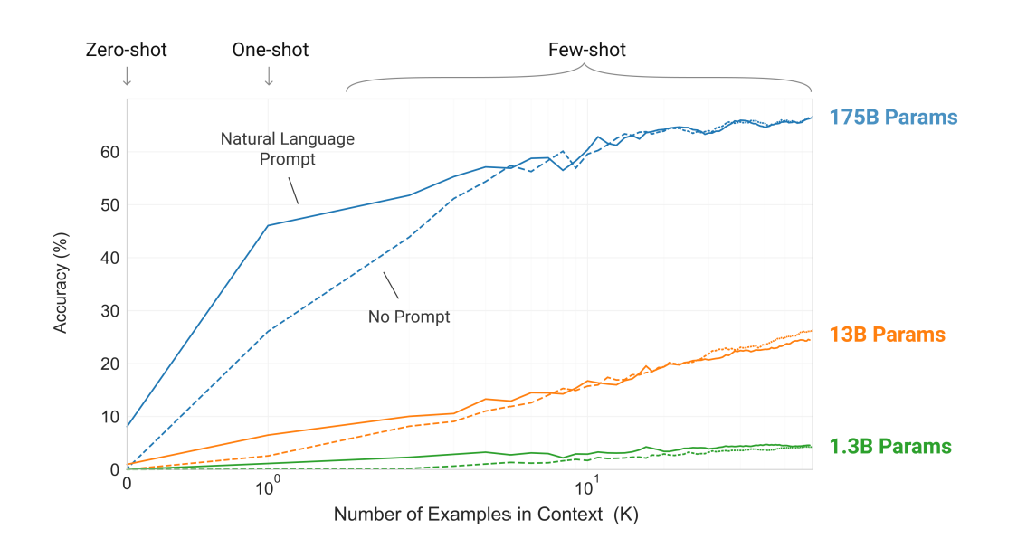
“Large Language Models are Few-shot Learners”
How it works
https://arxiv.org/abs/2005.14165
Notes:
So how does it work? Maybe we want to see behind the scene.
Using large corpus of text as a training set, LLMs train the model to predict next contents in an autoregressive way (GPT) or predict masked words. Instead of one model for one specific task at a time, multiple tasks are simultaneously trained together in one giant model. Through this multitask optimization, the language syntax and knowledge are reflected in model parameters, sometimes very large number of parameters. Because of it, LLM can be generalized to unseen tasks that it has never been trained for. So we can see LLMs are very good few-shot learner.

Slide 5
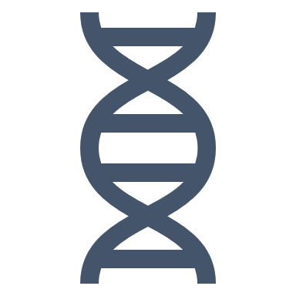
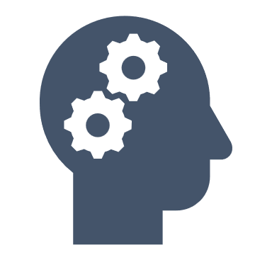




Are LLM good at using biomedical knowledge for reasoning?
Potential of LLM for biomedical prediction tasks
Challenge of biomedical prediction tasks
Small or no data to train models
Incorporating prior knowledge helps
What LLMs are good at:
Few-shot or zero-shot learning
Utilizing knowledge encoded in parameters
Let’s evaluate whether LLM can do biomedical few-shot predication task
Notes:
So, if LLM can extract knowledge and synthesize the knowledge to generate plausible answer, one idea strikes us. What about biomedical scientific knowledge.
Here we wanted to test whether current large language models are good at using biomedical knowledge for reasoning.
Indeed large language model has some characteristics that is critically needed for biomedical prediction tasks.
Here’s common challenges of biomedical prediction tasks.
Data size. Too small. Very limited data, expensive to obtain
Also, prior knowledge is important than in any other field.
What LLMs are good at are
few-shot learning
Utilizing knowledge encoded in parameters

Slide 6
CancerGPT

Slide 7
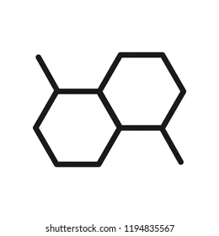
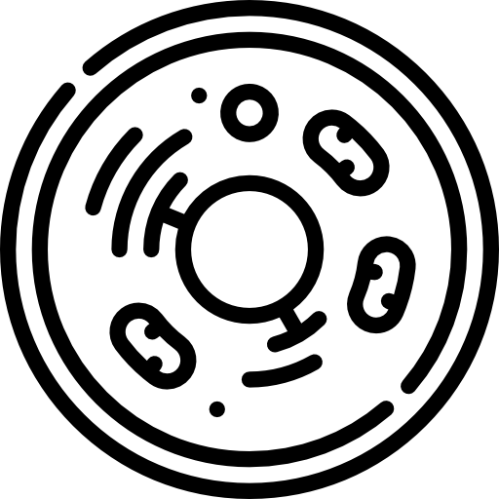







CancerGPT: Predicting drug pair synergy in rare cancer types
An example of biomedical prediction tasks with limited data
Predicting drug pair’s synergistic effect
Prediction
model
Synergistic effect?
Drug 1
Drug 2
Cell line
Challenges
Data distributions are skewed
Limited data
# data
Lung cancer
cell line
Bone cancer
cell line
Soft tissue cancer
cell line
Tissue type
https://arxiv.org/abs/2304.10946
Notes:
Here we needed to select a good biomedical prediction task to test the LLM.
We want to test LLM’s reasoning capability, not memorizing capability. So, the prediction shouldn’t be explicitly mentioned in text format, but we should be able to access to certain amount of ground truth so that we can evaluate.
And also the prediction should be complex enough and made by combining multiple stage of knowledge. We don’t want too straightforward task
So we picked the Drug pair synergy prediction in rare cancer type.
Generally, drug pair synergy prediction is like this. With two drugs and certain cell line, we’d like to predict synergy.
The challenge is, the data has long tail. For certain tissue, we don’t have enough data to train such model. And actually different tissues have very different characteristics, so we can’t simply extrapolate the model from one tissue to other tissue.

Slide 8
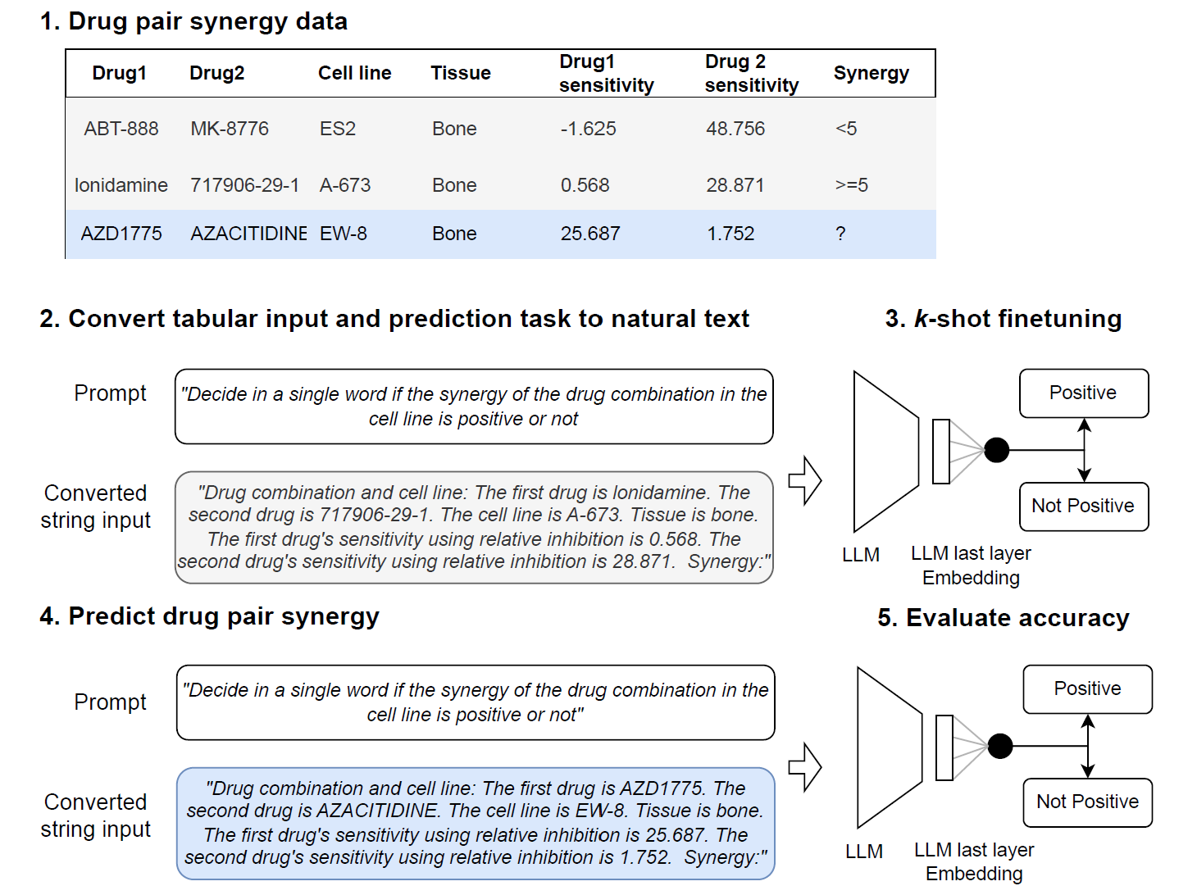
TabLLM, ATSTATS 2023, https://arxiv.org/abs/2210.10723

Slide 9
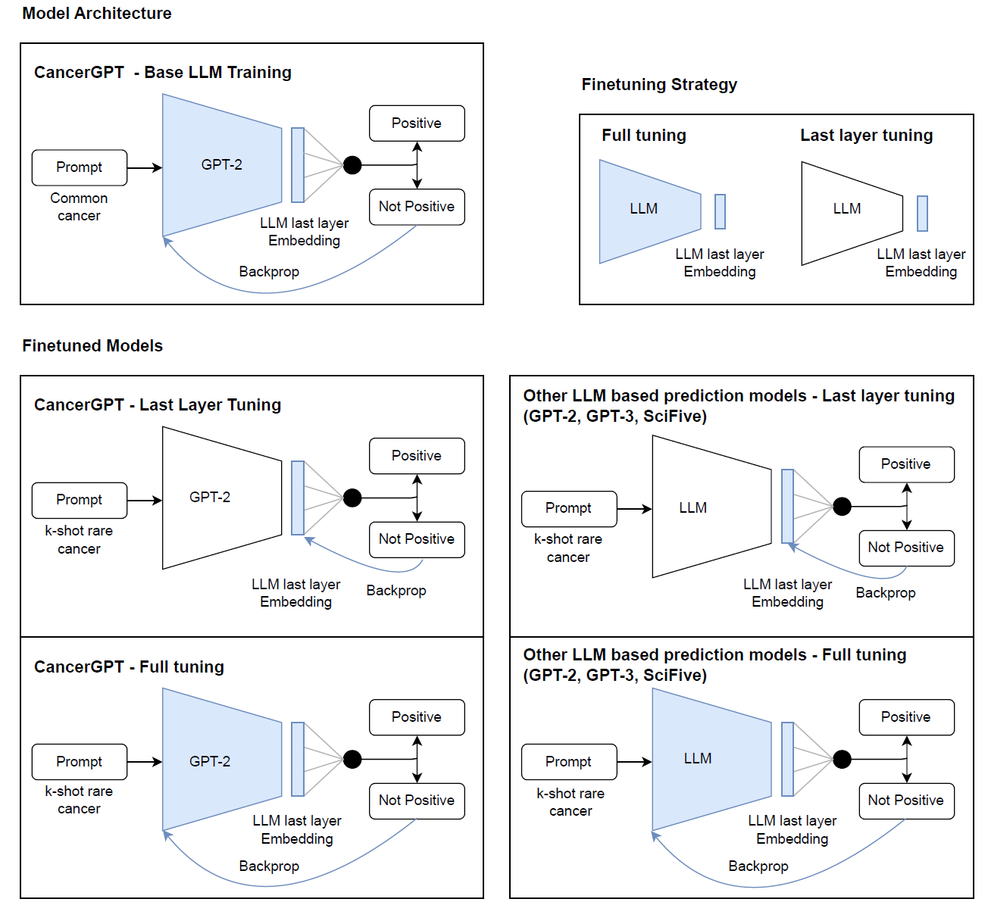

Slide 10
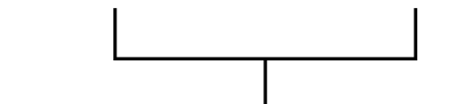
Fine tune the pre-trained LLMs
With k-shots of training data
Prompt
“Decide in a single word if the synergy of the drug combination in the cell line is positive or not “
Prediction
Label
LLM
“Positive"
>=5
Converted string input
"Drug combination and cell line: The first drug is lonidamine. The second drug is 717906-29-1. The cell line is A-673. Tissue is bone. The first drug's sensitivity using relative inhibition is 0.568. The second drug's sensitivity using relative inhibition is 28.871. Synergy:"
backpropagation
For GPT2, Add one linear layer on the last token of the GPT2 output and minimize cross entropy loss with binary label
For GPT3, fine tune GPT3.5 Ada using OpenAI API
Notes:
Then we fine tuned the model.
For GPT2, we used the last token and add one more layer. And tune the model to predict the binary label.
For GPT3, there’s no other choice but using OpenAI’s API and pay.

Slide 11
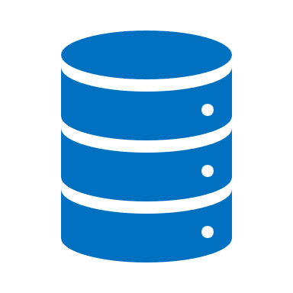
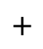
CancerGPT: Further fine tune the pre-trained LLMs
With large data from different sources
Drug pairs
Common tissue 1
1 0
0 0
0 1 …
Prior knowledge (corpora of text)
training
Common tissue 2
Source data
Cell lines
General
machine learning
GPT-2
GPT-3
CancerGPT
Common tissue 3
$$+$$
k-shot
finetuning
k-shot
finetuning
k-shot
finetuning
k-shot
finetuning
Rare
tissues
1 0 …
0 0 …
Target data
0 0 …
General machine learning = XGBoost, TabTransformer
Notes:
We gave some variation on the LLM.
We first used GPT2 or 3 and fine tuned using the target data (rare tissue of interest, where the evaluation will be made).
We further finetuned the GPT2. We used source data, which is data from different tissues with abundant data. They may follow different distribution to the target data, but still may or may not be useful. We call this model CancerGPT. The main difference between other models is that we fuse the prior knowledge of GPT and also abundant possibly task-related data.
We also built just general machine learning models that only used the source data. For general machine learning we used XGBoost and TabTransformer. TabTransformer is a deep learning method that learn the similarity between features and boost the accuracy even with limited data.

Slide 12
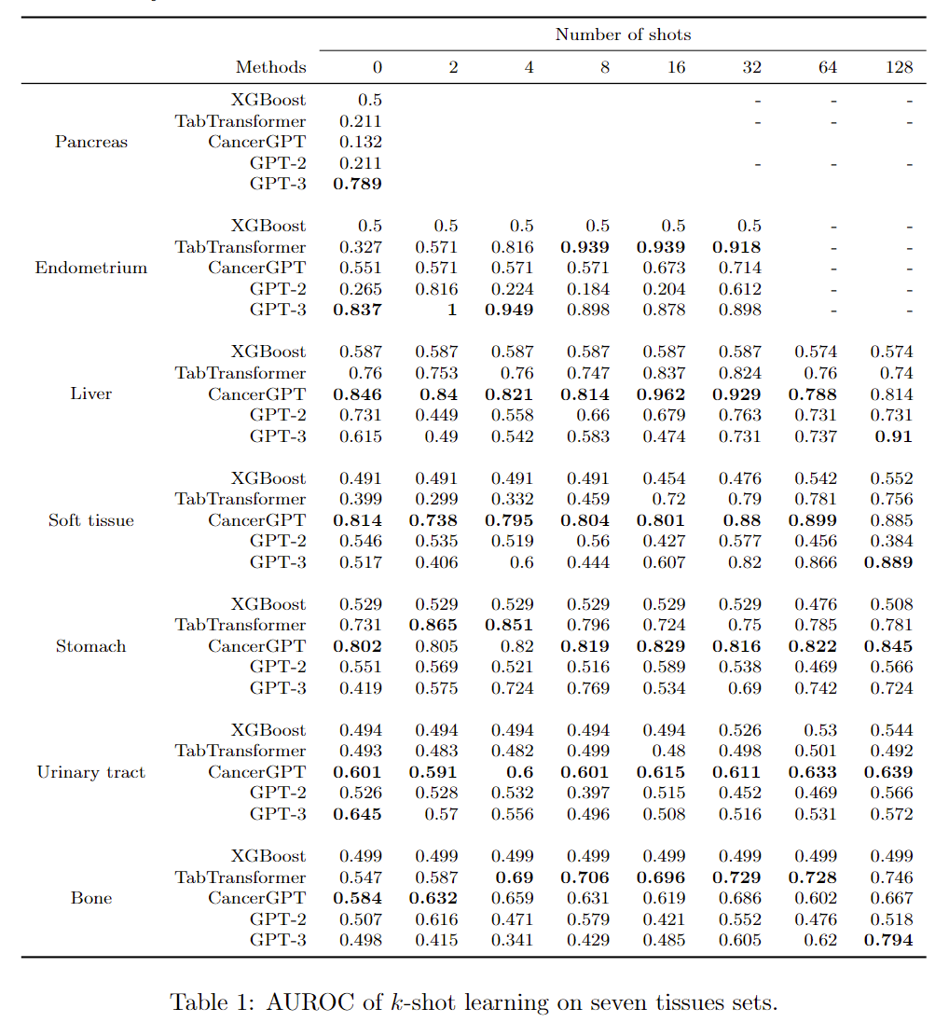
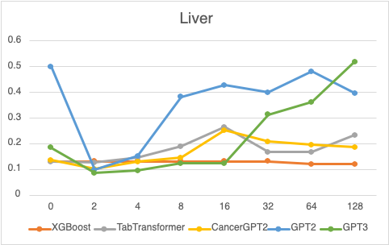
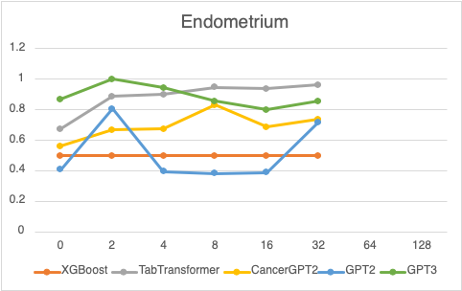
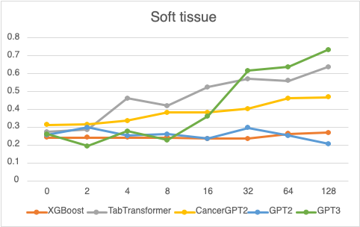
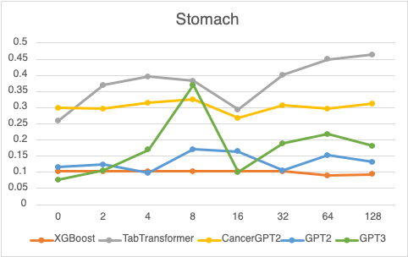
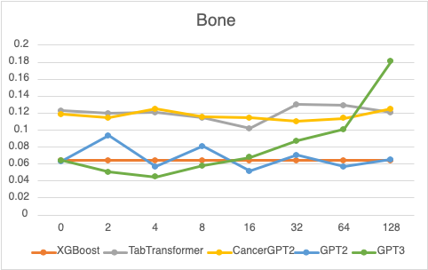
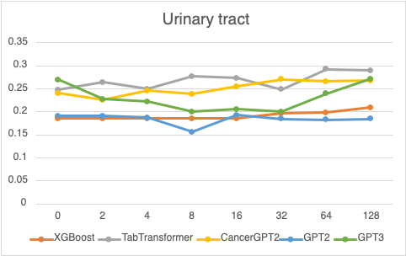
CancerGPT
TabTransformer
AUPRC
AUPRC
AUPRC
AUPRC
AUPRC
AUPRC
# training data (k)
# training data (k)
Notes:
Results: AUPRC of k-shot learning on seven tissue sets
Left: GPT3 gains accuracy very fast with more shots.
Right: TabTransformer, general machine learning, was consistent winner.
The winners are different based on tissue data.
Here, we looked in the characteristic of tissues. We need to see whether the source data are in distribution or out-of-distribution to the target data.

Slide 13
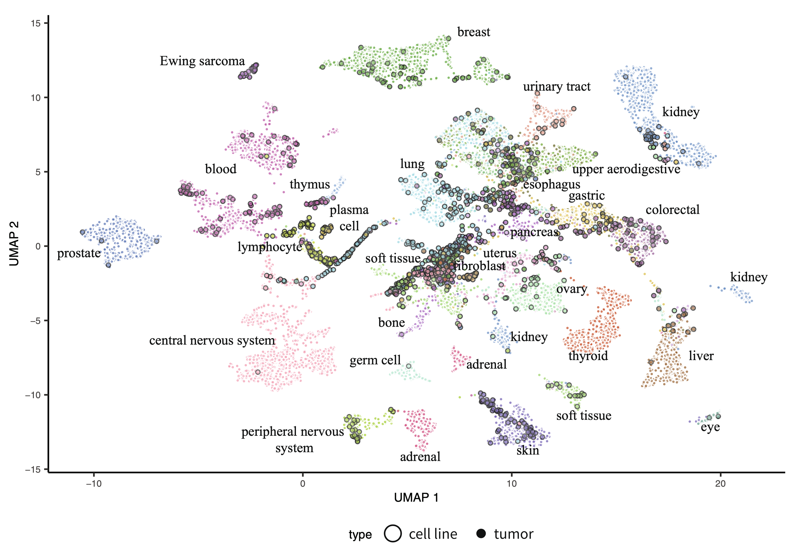
Cancer cell line gene expression (Nature Communication 2021)
CancerGPT works best
heterogeneous to other common cell lines
TabTransformer works best
Relatively homogeneous to other common cell lines
https://doi.org/10.1038/s41467-020-20294-x
Notes:
So, we examined the characteristic of tissues based on gene expression. It’s UMAP plot.
Tissues in the middle are similar each other; tissues in the outer sides are relatively distinct.
Interestingly, the tissues that GPT3 showed good accuracy was at the peripheral area.
The tissues that tabtransformer showed good accuracy was more around center and similar each other.

Slide 14
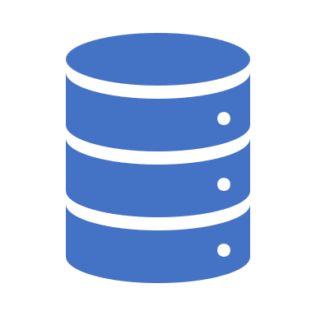
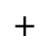

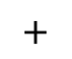


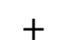
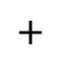
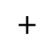
So, what does it mean?
To summarize in human language…
Source data
(common tissues)
Target data
(Rare tissue of interest)
$$∼$$
In distribution
Knowledge-driven prediction wins
Data-driven prediction wins
GPT2
General machine
learning
$$+$$
CancerGPT
>
$$+$$
<
$$+$$
<
GPT3
GPT3
CancerGPT
General machine learning
No target data to train (k)
More target data to train (k)
Knowledge-guided prediction wins
GPT2
General machine
learning
$$+$$
>
$$+$$
$$∼$$
$$+$$
CancerGPT
>
GPT3
CancerGPT
General machine learning
GPT3
$$≠$$
Out-of- distribution

Slide 15

Any hallucination, Any memorization?
Fact Check GPT3’s reasoning
“Why is the drug pair AZD-4877 and AZD1208 synergistic in the cell line T24?”
“The combination of AZD-4877 and AZD1208 has been studied in T24 cells...to be synergistic in reducing bladder cancer cell growth and metastasis”
“The combination was also found to target multiple pathways involved in the growth and spread of bladder cancer cells.”
“...Specifically, AZD-4877 was found to inhibit the activation of proteins involved in the promotion of tumor growth...”
“...AZD1208 was found to inhibit proteins associated with the inhibition of tumor growth.”
“This combination was also effective at reducing the production of inflammatory mediators such as cytokines, which are known to con- tribute to tumor progression.”
“...these two drugs have been shown to reduce levels of apoptosis inhibitors, which can also play a role in tumor progression.”
GPT3
Notes:
One benefit of LLM-based prediction was that we can ask the reasoning behind.
This is one example of true positive prediction. We asked why. Checked whether its statement is based on fact or hallucination. When we cross checked with external scientific literature, we found that some are hallucination and some are right.
And for many other cases, the reasoning was not very convincing.
Prompt: Determine the drug synergy combination for the given cancer drug combination. Allowed synergies: {synergistic, antagonistic} Combination: The first drug is AZD-4877. The second drug is AZD1208. Cell line is T24. Tissue is urinary_tract. Synergy: synergistic. Why are drugs AZD-4877 and AZD1208 synergistic in cell line T24 for urinary tract cancer?
Answer: The combination of AZD-4877 and AZD1208 has been studied in T24 cells, a cell line derived from a human bladder cancer cell line. In this study, the combination of AZD-4877 and AZD1208 was found to be synergistic in reducing bladder cancer cell growth and metastasis. The combination was also found to target multiple pathways involved in the growth and spread of bladder cancer cells. Specifically, AZD-4877 was found to inhibit the activation of proteins involved in the promotion of tumor growth while AZD1208 was found to inhibit proteins associated with the inhibition of tumor growth. This combination was also effective at reducing the production of inflammatory mediators such as cytokines, which are known to contribute to tumor progression. Furthermore, when used together, these two drugs have been shown to reduce levels of apoptosis inhibitors, which can also play a role in tumor progression. Together, these findings suggest that this drug combination is synergistic for treating urinary tract cancers in T24 cells.

Slide 16
To conclude
Summary and contribution
General insight to machine learning
When data size is limited, LLMs can be a good few-shot prediction tool based on knowledge
But LLM’s reasoning sometimes contains hallucination
Biomedical contribution
First prediction model for drug pair synergy in rare cancer types
Can be extended to a wide range of application beyond cancer, particularly when data is limited

Slide 17
Other LLMs

Slide 18
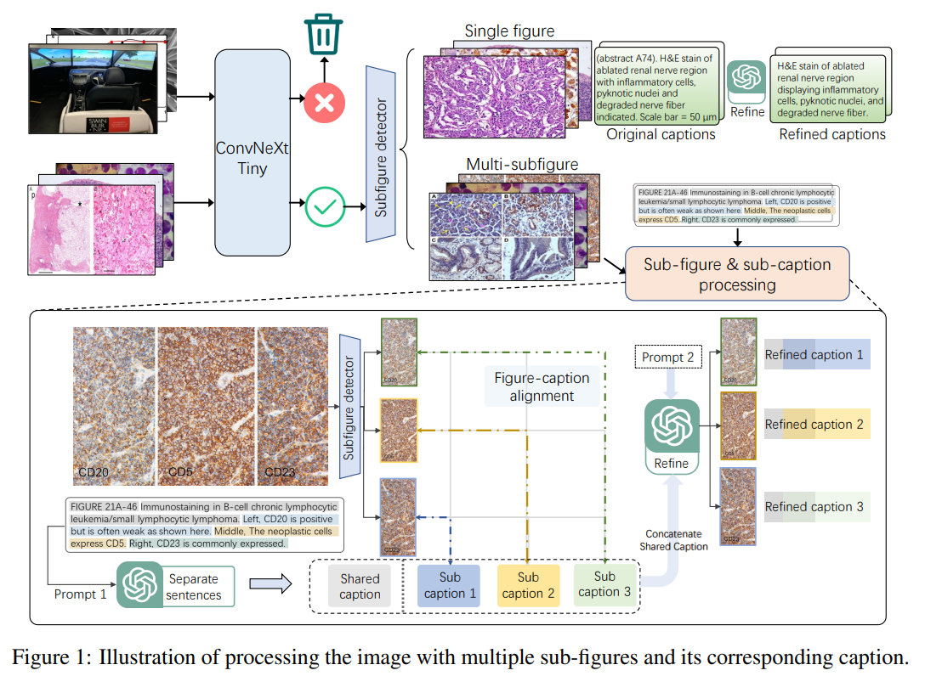
Pathology with LLM
https://arxiv.org/pdf/2305.15072.pdf

Slide 19
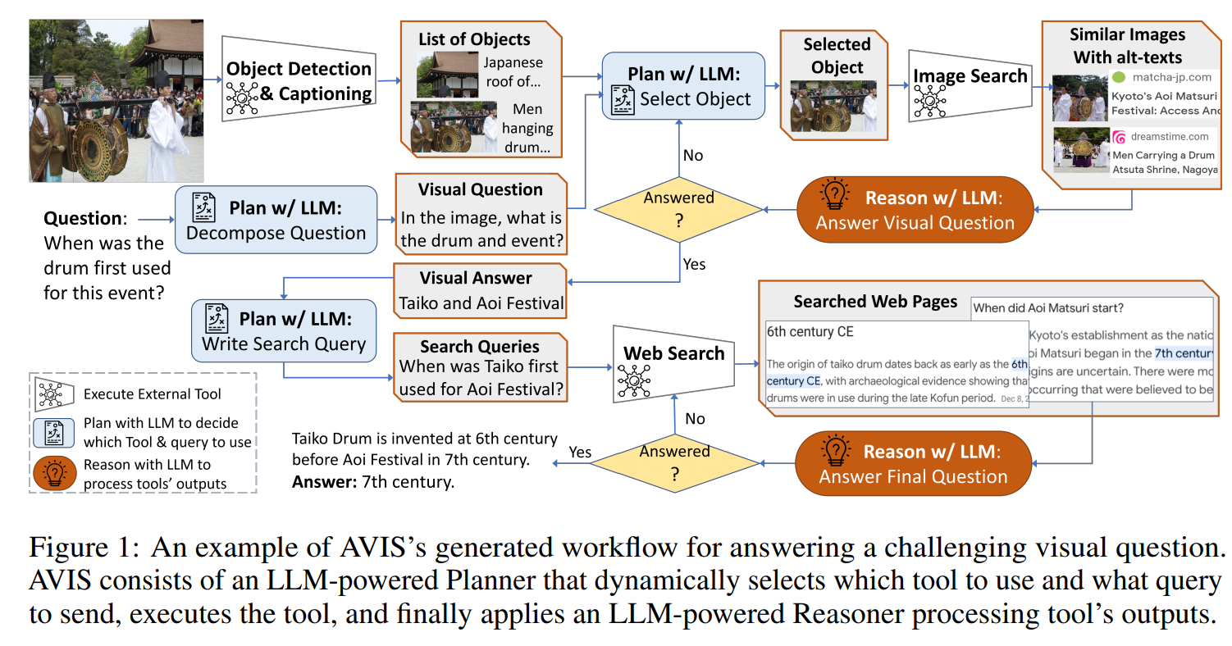
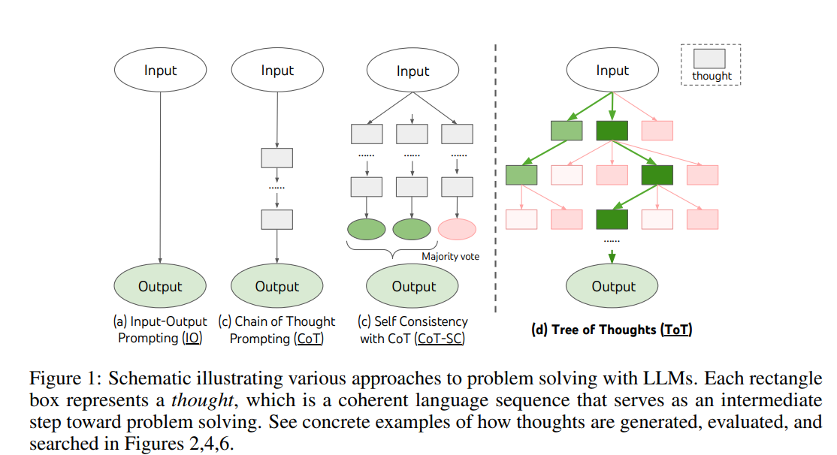
Tree of Thoughts
https://arxiv.org/pdf/2306.08129.pdf
https://arxiv.org/pdf/2305.10601.pdf

Slide 20
CancerGPT Tutorial

Slide 21
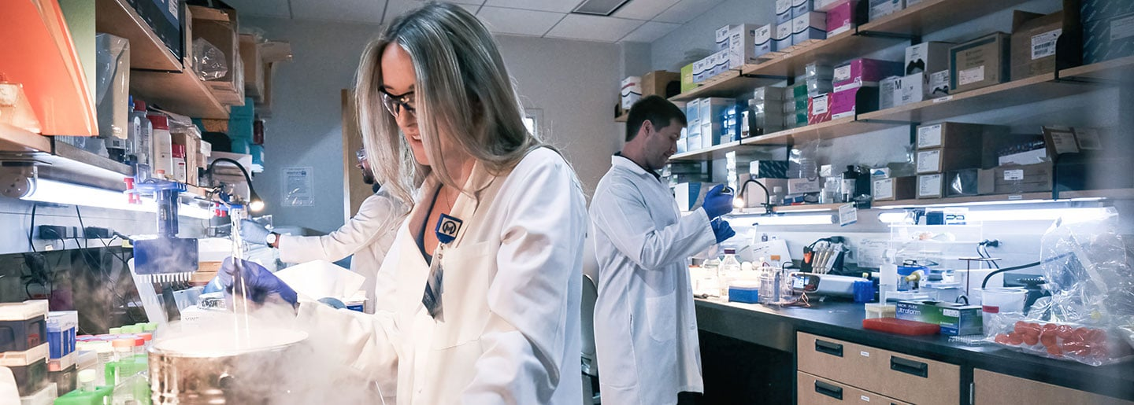
An example in healthcare: Drug synergy prediction
Drug synergy refers to the phenomenon where the combined effect of two drugs is greater than their individual effects.
Researchers usually use experimental methods to find potential drug combination for cancer treatment. However, it is expensive and time-consuming.
https://www.nature.com/articles/nchembio.1205

Slide 22
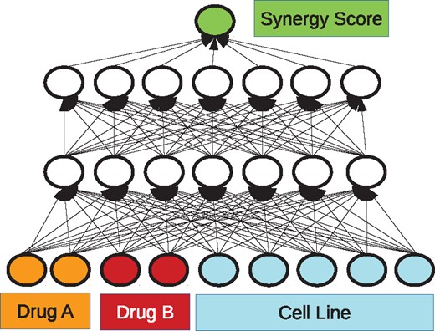
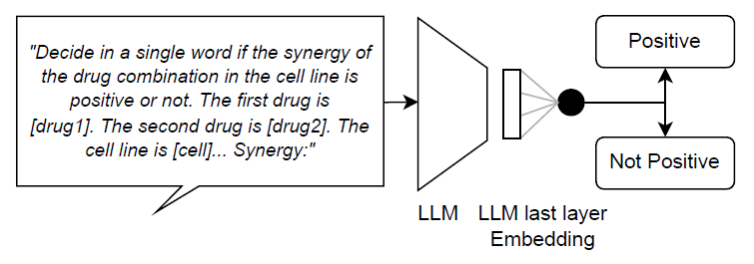
Deep learning in drug synergy prediction
Some previous works use machine learning models to predict synergy. However, with limited data and features, the performance of rare cancers is poor.
Leveraging prior knowledge in scientific literature encoded in LLMs is a new way to predict drug synergy for cancers.
https://academic.oup.com/bioinformatics/article/34/9/1538/4747884

Slide 23
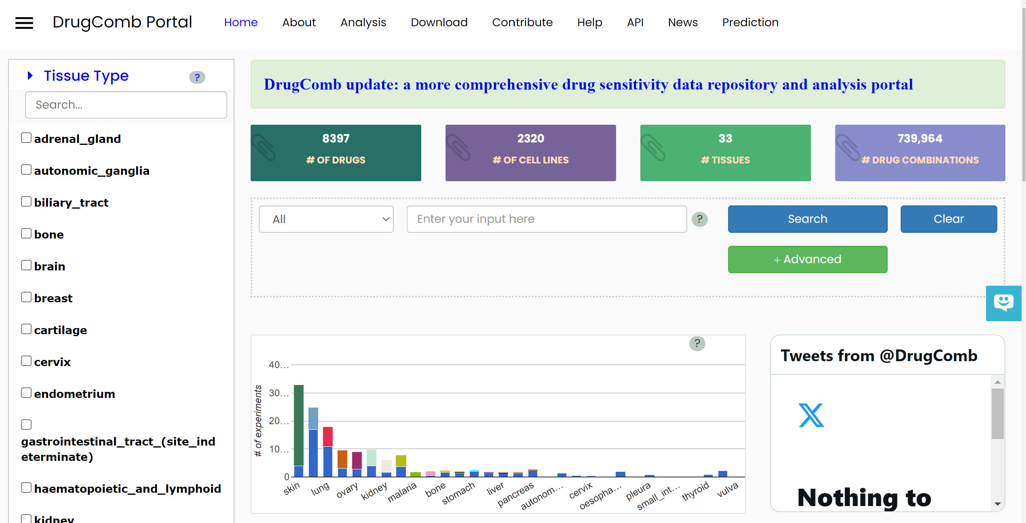
Dataset
https://drugcomb.fimm.fi/

Slide 24
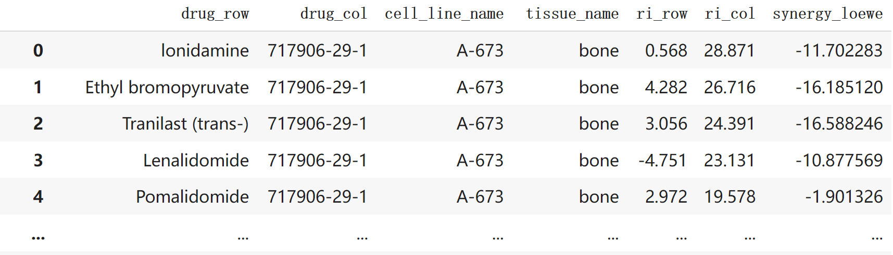
Drug synergy prediction using LLM
Task: Given two drugs and a cell line, determine whether the drugs have synergistic effect on the cell line, based on each drug’s sensitivity to the cell line
Data: DrugComb dataset
https://drugcomb.fimm.fi/

Slide 25

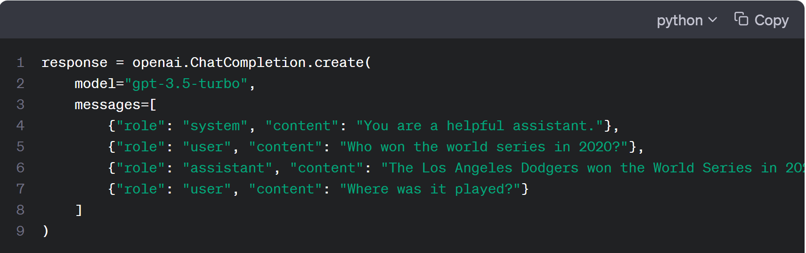
ChatGPT API
OpenAI's GPT models have been trained to understand natural language and code. GPTs provide text outputs in response to their inputs.
To use a GPT model via the OpenAI API, you’ll send a request containing the inputs and your API key, and receive a response containing the model’s output.
https://platform.openai.com/docs/guides/gpt

Slide 26
Advantages using ChatGPT API
Integration into Applications
The primary advantage of the API is that developers can integrate ChatGPT into their own applications, services, or platforms. This could be anything from a mobile app, a web service, a chatbot, to a research tool.
Automation & Workflow
Through the API, businesses can automate certain tasks or services. For example, a company might use the API to provide automated customer support on their website.
Customization
With the API, developers can create custom workflows, integrate the system with their databases, and generally tailor the experience to their needs.
E.g. Get embeddings from ChatGPT model
Scalability
When integrated into a product, the API allows for scaling up the usage based on demand. If a developer wants to have multiple simultaneous conversations, they can do so using the API.

Slide 27
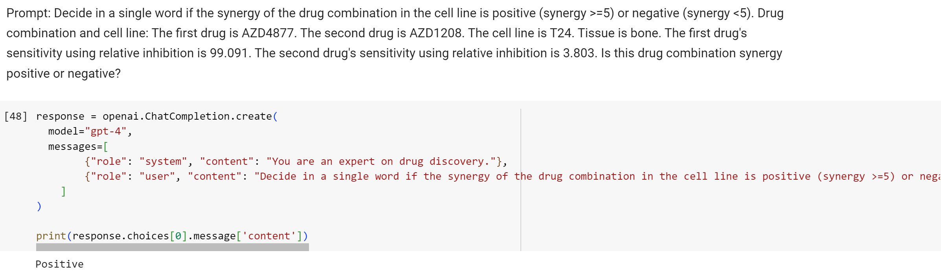
Zero shot learning by ChatGPT: Prompt Engineering
Send a request to ChatGPT API using prompt

Slide 28
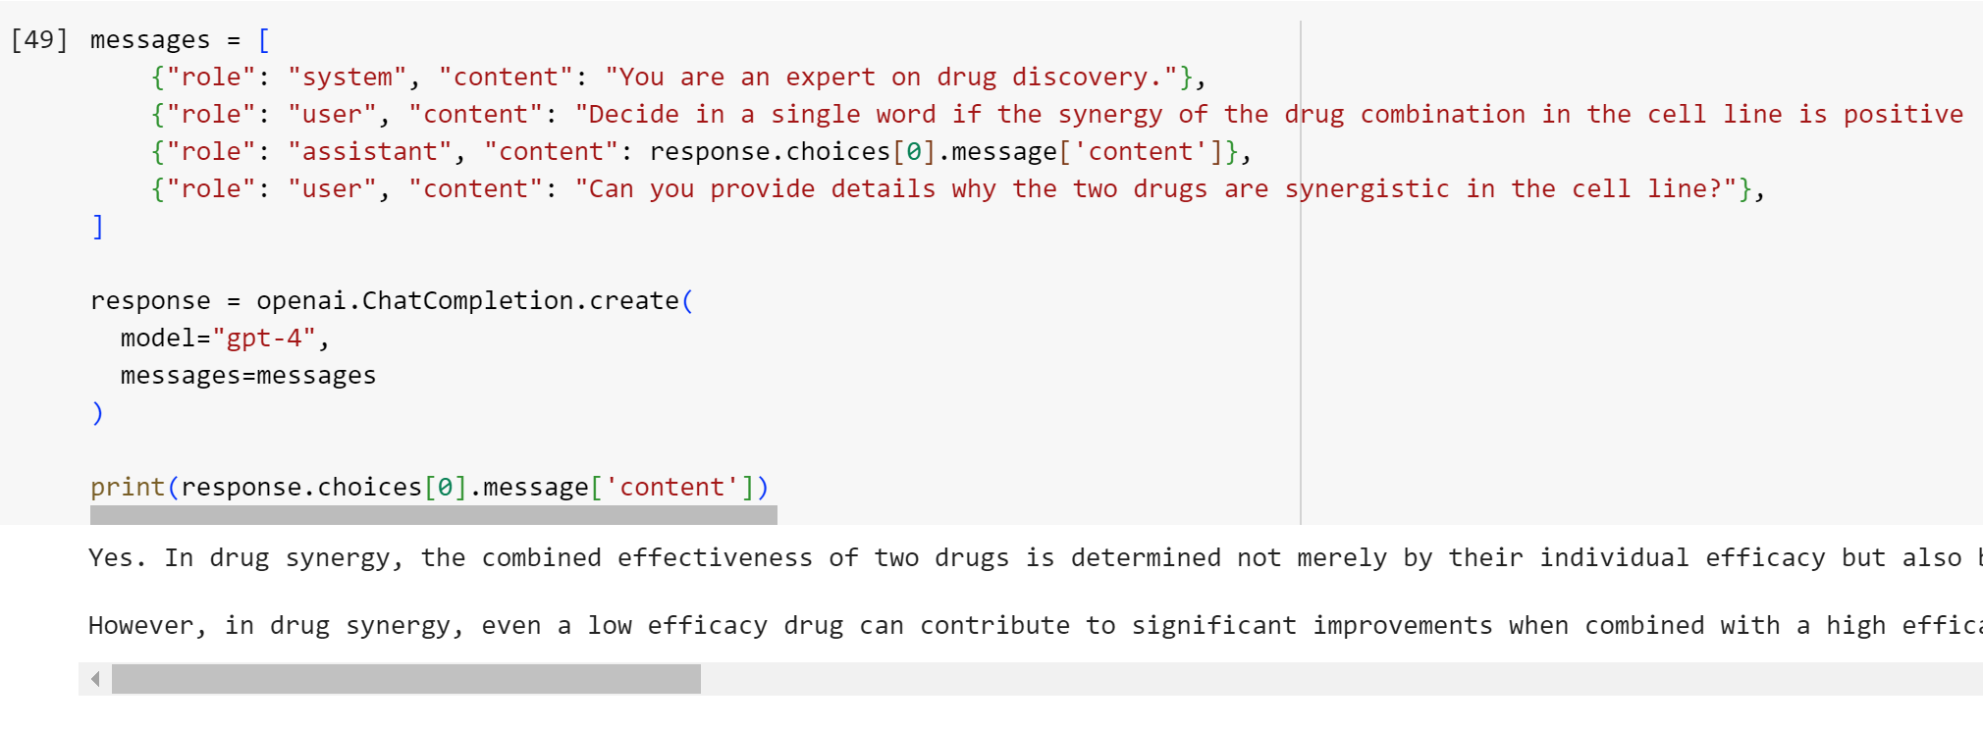
In-context learning: ChatGPT Prompt
Adding a role to boost up ChatGPT performance
Request explanation
https://promptengineering.org/role-playing-in-large-language-models-like-chatgpt/

Slide 29
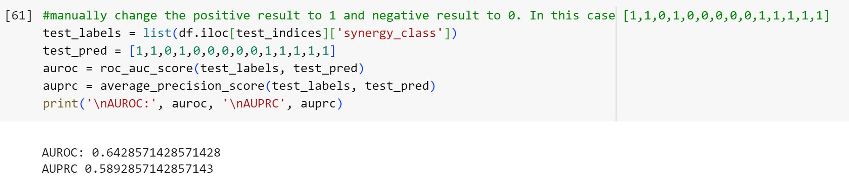
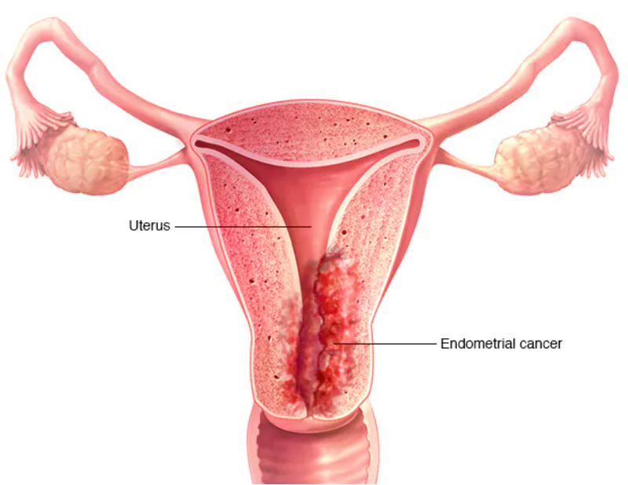
Zero-shot ChatGPT synergy prediction on endometrium

Slide 30
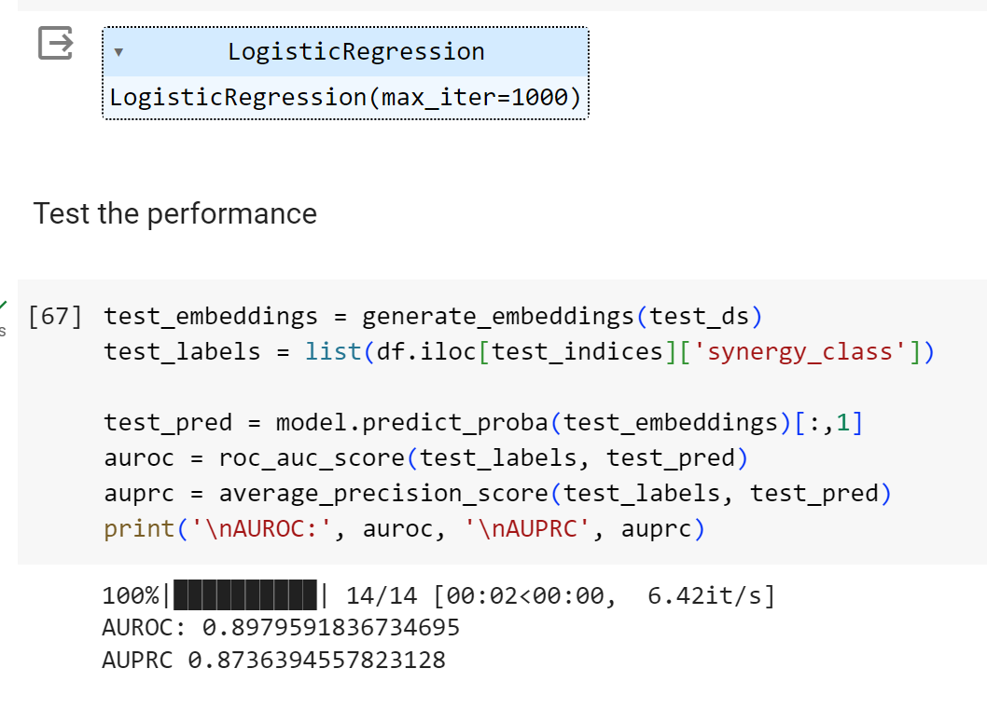
Get embeddings from ChatGPT
Embeddings are internal representations that the ChatGPT model learned during its training process, which are high-dimensional vectors
The length of embedding for GPT-3.5 model “text-embedding-ada-002” is 1536
Logistic Regression based on GPT-3.5 embeddings can significantly improve the performance
https://platform.openai.com/docs/guides/embeddings

Slide 31
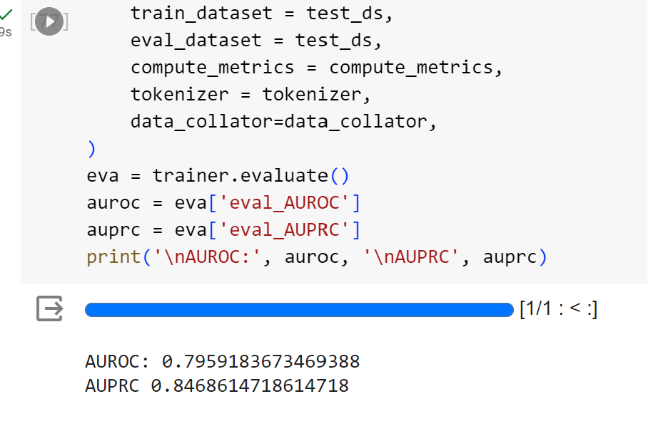
Get embeddings from CancerGPT
ChatGPT is not an open-source model and cannot be used for large-scale finetuning
However, finetuning on common cancer data boosts performance on rare cancer data
We finetuned a GPT-2 model (CancerGPT) before and compared it with ChatGPT.
https://arxiv.org/abs/2304.10946

Slide 32
Comparison of different models
In Endometrium cancer, CancerGPT is better than basic ChatGPT, but not as good as ChatGPT embedding + classification.
However, CancerGPT (~124M) is much smaller than ChatGPT (~175B)
https://arxiv.org/abs/2304.10946

